Slide 1

ASIA

Slide 2
ASIA
MEMBER COUNTRIES
Philippines
Myanmar
OBSERVER COUNTRIES
Korea
India
Laos
Lebanon
Thailand

Slide 3


Slide 4
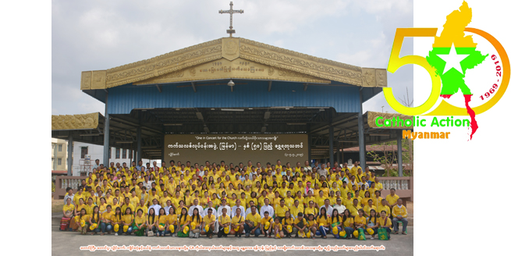

50° CA MYANMAR
Golden Jubilee 2019

Slide 5
