Slide 1
Listening to the continents
Europe-Mediterranean

Slide 2
Europe-Mediterranean
MEMBER COUNTRIES
Albania
Austria
Italy
Malta
Poland
Romania
Spain
Switzerland (Italian Lugano)
HOLY LAND (Israel, Palestine, Jordan)
OBSERVER COUNTRIES
Bosnia Herzegovina
Bulgaria
Croatia
France
Germany
Lithuania
Portugal
Czech Republic
Mondava Republic
Slovakia
Ukraine
Hungary

Slide 8
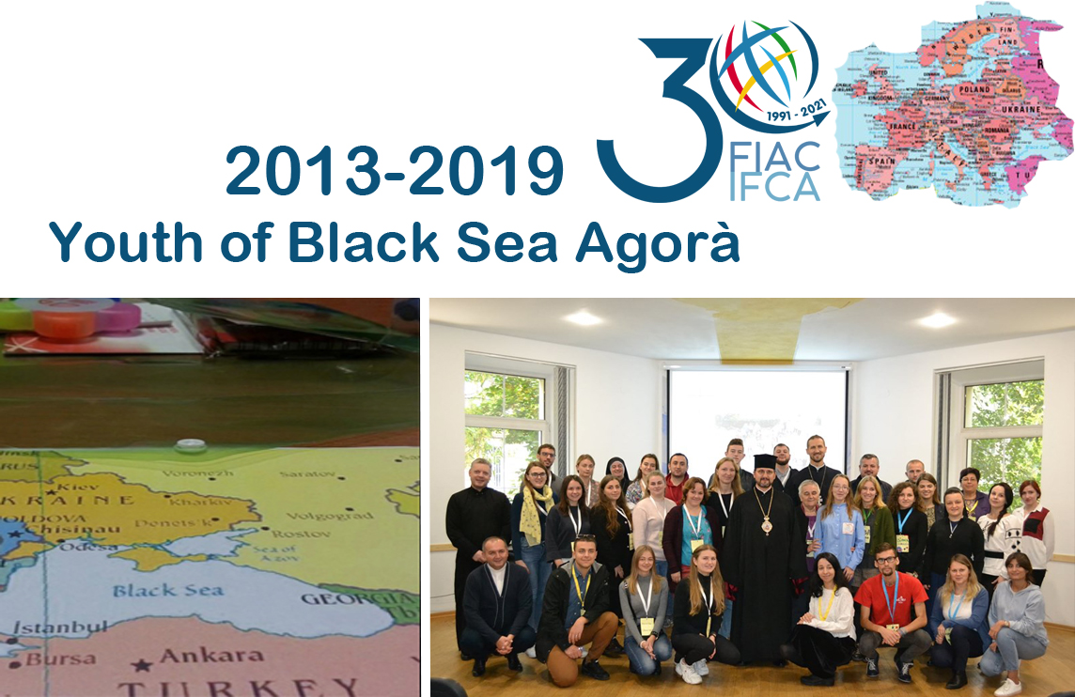

Slide 11
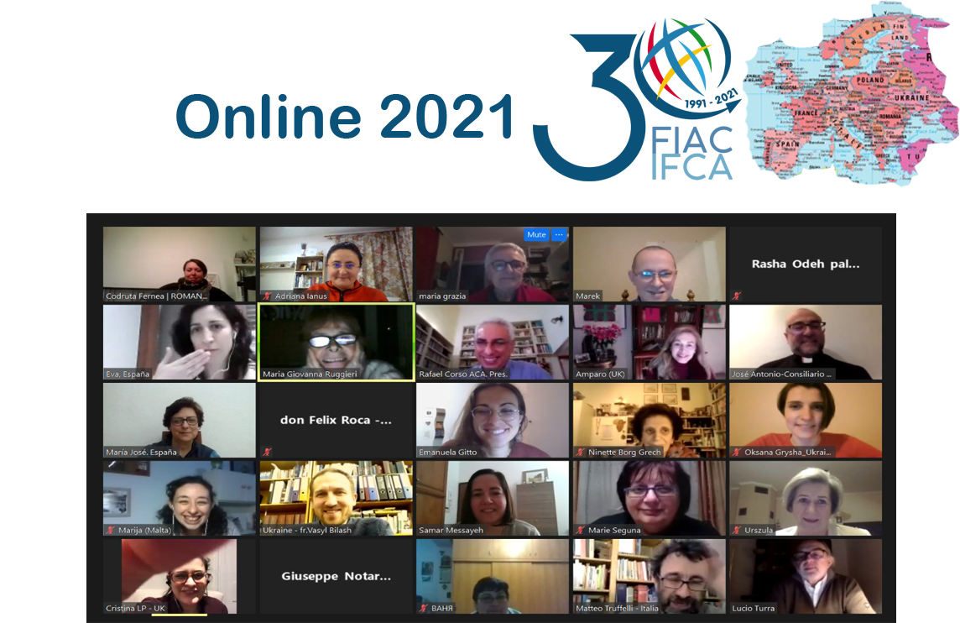

Slide 12
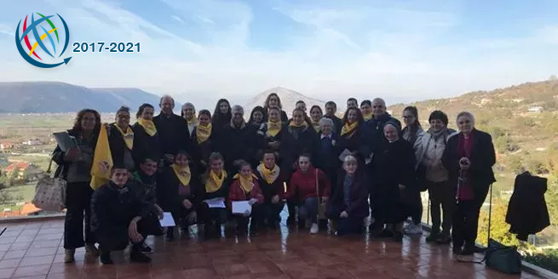
A new Catholic Action in Albania

Slide 13
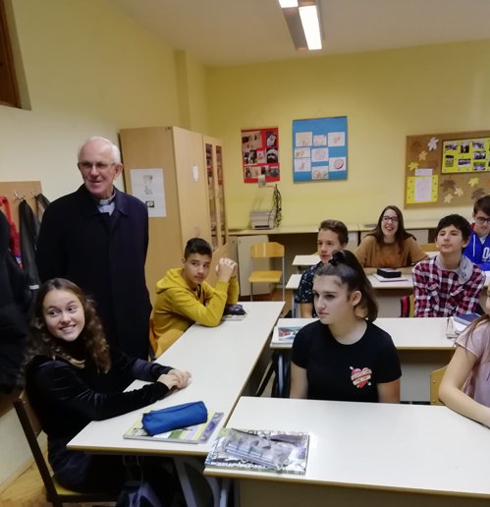
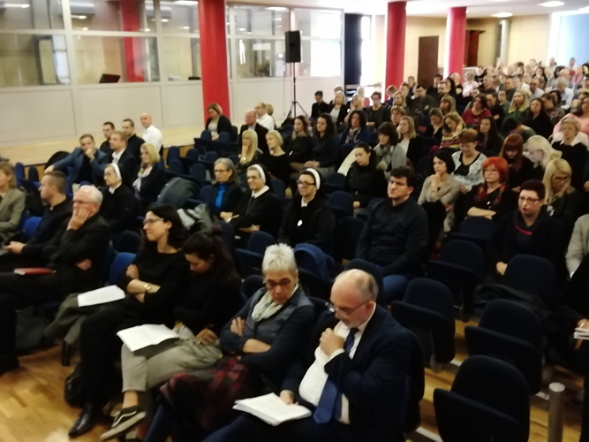
Mi smo s vama (Siamo con voi)
25 years of friendship of CA Italy with the Interethnic Schools for Europe in Sarajevo

